Slide 1

演算法分組報告
量子程式Exercise 2-2
報告組別：50
成員：蘇正、魏子翔、何伊倫

Slide 2
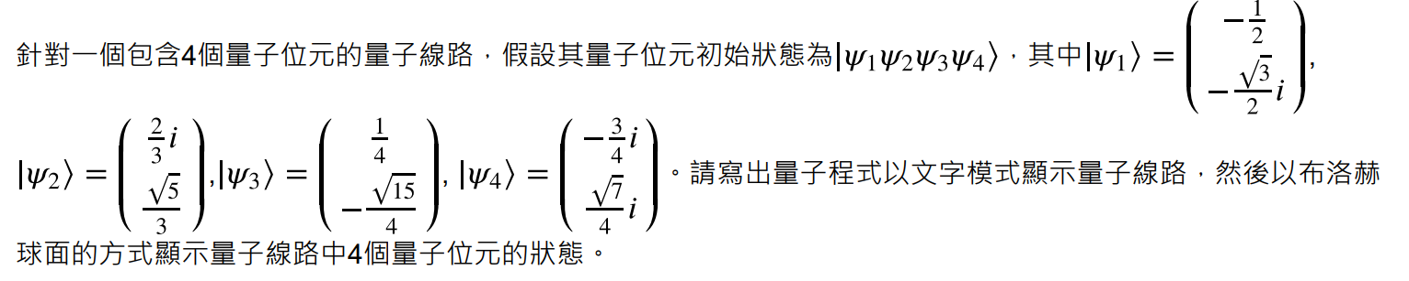
Exercise 2-2 題目介紹

Slide 3
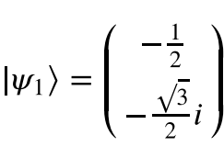
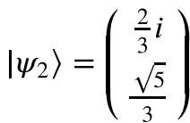
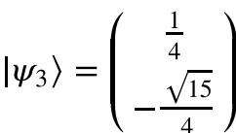
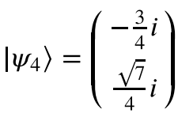
Exercise 2-2 程式解說
from qiskit import QuantumCircuit
from qiskit.quantum_info import Statevector
import math
qc = QuantumCircuit(4,4)
qc.initialize([-1/2, math.sqrt(3)/2j],0)
qc.initialize([2j/3, math.sqrt(5)/3],1)
qc.initialize([1/4, -math.sqrt(15)/4],2)
qc.initialize([-3j/4, -math.sqrt(7)/4j],3)
print(qc)
state = Statevector.from_instruction(qc)
state.draw('bloch')

Slide 4

Exercise 2-2 程式解說
from qiskit import QuantumCircuit
from qiskit.quantum_info import Statevector
import math
qc = QuantumCircuit(4,4)
qc.initialize([-1/2, math.sqrt(3)/2j],0)
qc.initialize([2j/3, math.sqrt(5)/3],1)
qc.initialize([1/4, -math.sqrt(15)/4],2)
qc.initialize([-3j/4, -math.sqrt(7)/4j],3)
print(qc)
state = Statevector.from_instruction(qc)
state.draw('bloch')
$←$使用import從qiskit引入QuantumCirsuit

Slide 5
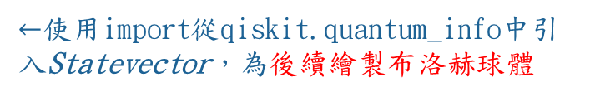
Exercise 2-2 程式解說
from qiskit import QuantumCircuit
from qiskit.quantum_info import Statevector
import math
qc = QuantumCircuit(4,4)
qc.initialize([-1/2, math.sqrt(3)/2j],0)
qc.initialize([2j/3, math.sqrt(5)/3],1)
qc.initialize([1/4, -math.sqrt(15)/4],2)
qc.initialize([-3j/4, -math.sqrt(7)/4j],3)
print(qc)
state = Statevector.from_instruction(qc)
state.draw('bloch')
$←$使用import從qiskit.quantum_info中引入Statevector，為後續繪製布洛赫球體

Slide 6
Exercise 2-2 程式解說
from qiskit import QuantumCircuit
from qiskit.quantum_info import Statevector
import math
qc = QuantumCircuit(4,4)
qc.initialize([-1/2, math.sqrt(3)/2j],0)
qc.initialize([2j/3, math.sqrt(5)/3],1)
qc.initialize([1/4, -math.sqrt(15)/4],2)
qc.initialize([-3j/4, -math.sqrt(7)/4j],3)
print(qc)
state = Statevector.from_instruction(qc)
state.draw('bloch')
$←$為了要做根號(sqrt)的運算，所以使用import引入math

Slide 7
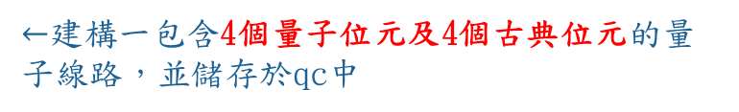
Exercise 2-2 程式解說
from qiskit import QuantumCircuit
from qiskit.quantum_info import Statevector
import math
qc = QuantumCircuit(4,4)
qc.initialize([-1/2, math.sqrt(3)/2j],0)
qc.initialize([2j/3, math.sqrt(5)/3],1)
qc.initialize([1/4, -math.sqrt(15)/4],2)
qc.initialize([-3j/4, -math.sqrt(7)/4j],3)
print(qc)
state = Statevector.from_instruction(qc)
state.draw('bloch')
$←$建構一包含4個量子位元及4個古典位元的量子線路，並儲存於qc中

Slide 8
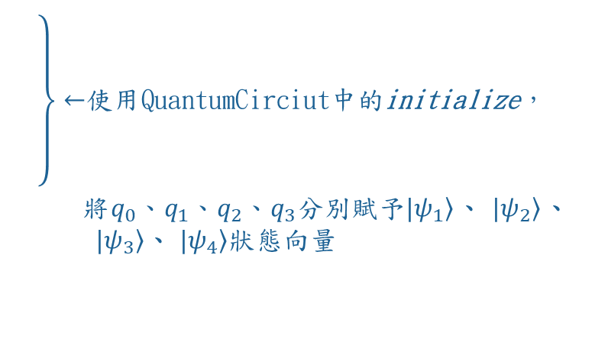
Exercise 2-2 程式解說
from qiskit import QuantumCircuit
from qiskit.quantum_info import Statevector
import math
qc = QuantumCircuit(4,4)
qc.initialize([-1/2, math.sqrt(3)/2j],0)
qc.initialize([2j/3, math.sqrt(5)/3],1)
qc.initialize([1/4, -math.sqrt(15)/4],2)
qc.initialize([-3j/4, -math.sqrt(7)/4j],3)
print(qc)
state = Statevector.from_instruction(qc)
state.draw('bloch')
$\left.\begin{aligned} \\ \\ \\ \\ \\ \end{aligned}\right\}←$使用QuantumCirciut中的initialize， 將$q_{0}、q_{1}、q_{2}、q_{3}分別賦予|\left.ψ_{1}\right\rangle$、 $|\left.ψ_{2}\right\rangle$、 $|\left.ψ_{3}\right\rangle$、 $|\left.ψ_{4}\right\rangle 狀態向量$

Slide 9
Exercise 2-2 程式解說
from qiskit import QuantumCircuit
from qiskit.quantum_info import Statevector
import math
qc = QuantumCircuit(4,4)
qc.initialize([-1/2, math.sqrt(3)/2j],0)
qc.initialize([2j/3, math.sqrt(5)/3],1)
qc.initialize([1/4, -math.sqrt(15)/4],2)
qc.initialize([-3j/4, -math.sqrt(7)/4j],3)
print(qc)
state = Statevector.from_instruction(qc)
state.draw('bloch')
$←$將量子線路qc使用文字形式繪製出來

Slide 10
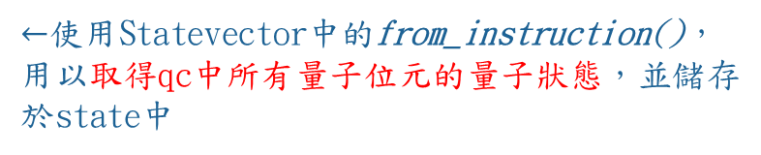
Exercise 2-2 程式解說
from qiskit import QuantumCircuit
from qiskit.quantum_info import Statevector
import math
qc = QuantumCircuit(4,4)
qc.initialize([-1/2, math.sqrt(3)/2j],0)
qc.initialize([2j/3, math.sqrt(5)/3],1)
qc.initialize([1/4, -math.sqrt(15)/4],2)
qc.initialize([-3j/4, -math.sqrt(7)/4j],3)
print(qc)
state = Statevector.from_instruction(qc)
state.draw('bloch')
$←$使用Statevector中的from_instruction()，用以取得qc中所有量子位元的量子狀態，並儲存於state中

Slide 11
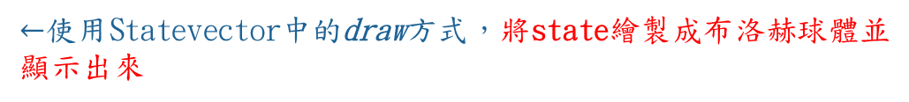
Exercise 2-2 程式解說
from qiskit import QuantumCircuit
from qiskit.quantum_info import Statevector
import math
qc = QuantumCircuit(4,4)
qc.initialize([-1/2, math.sqrt(3)/2j],0)
qc.initialize([2j/3, math.sqrt(5)/3],1)
qc.initialize([1/4, -math.sqrt(15)/4],2)
qc.initialize([-3j/4, -math.sqrt(7)/4j],3)
print(qc)
state = Statevector.from_instruction(qc)
state.draw('bloch')
$←$使用Statevector中的draw方式，將state繪製成布洛赫球體並顯示出來

Slide 12
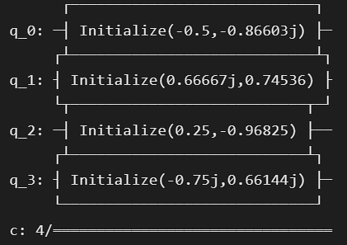
Exercise 2-2 結果呈現
(一)文字模式顯示量子線路

Slide 13
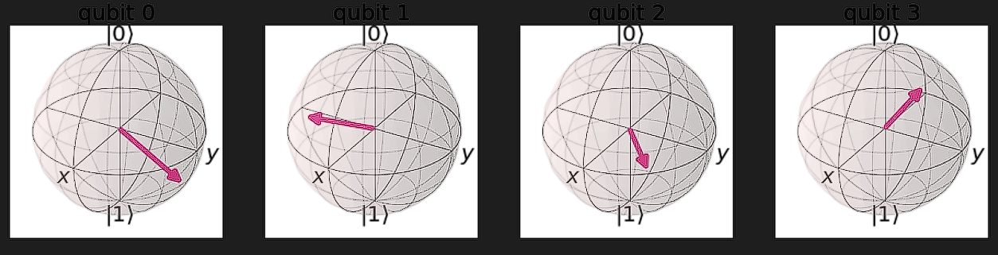
Exercise 2-2 結果呈現
Qubit 0
Qubit 1
Qubit 2
Qubit 3
(二)以布洛赫球面顯示量子線路4個量子位元之狀態

Slide 14
Q&A
?

Slide 15
The end
⠂⠂⠂⠂⠂⠂⠂⠂▀████▀▄▄⠂⠂⠂⠂⠂⠂⠂⠂⠂⠂⠂⠂⠂⠂▄█ ⠂⠂⠂⠂⠂⠂⠂⠂⠂⠂█▀░░░░▀▀▄▄▄▄▄⠂⠂⠂⠂▄▄▀▀█ ⠂⠂⠂▄⠂⠂⠂⠂⠂⠂⠂█░░░░░░░░░░░▀▀▀▀▄░░▄▀ ⠂▄▀░▀▄⠂⠂⠂⠂⠂⠂▀▄░░░░░░░░░░░░░░▀▄▀ ▄▀░░░░█⠂⠂⠂⠂⠂⠂█▀░░░▄█▀▄░░░░░░▄█ ▀▄░░░░░▀▄⠂⠂⠂█░░░░░▀██▀░░░░░██▄█ ⠂⠂▀▄░░░░▄▀⠂█░░░▄██▄░░░▄░░▄░░▀▀░█ ⠂⠂⠂█░░▄▀⠂⠂█░░░░▀██▀░░░░▀▀░▀▀░░▄▀
⠂⠂█░░░█⠂⠂█░░░░░░▄▄░░░░░░░░░░░▄▀ ⠂█░░░█⠂⠂█▄▄░░░░░░░▀▀▄░░░░░░▄░█ ⠂⠂▀▄░▄█▄█▀██▄░░▄▄░░░▄▀░░▄▀▀░░░█ ⠂⠂⠂⠂▀███░░░░░░░░░▀▀▀░░░░▀▄░░░▄▀ ⠂⠂⠂⠂⠂⠂▀▀█░░░░░░░░░▄░░░░░░▄▀█▀ ⠂⠂⠂⠂⠂⠂⠂⠂▀█░░░░░▄▄▄▀░░▄▄▀▀░▄▀ ⠂⠂⠂⠂⠂⠂⠂⠂⠂⠂▀▀▄▄▄▄▀⠂▀▀▀⠂▀▀▄▄▄▀

